Slide 1

Uber VS Lyft

Slide 2
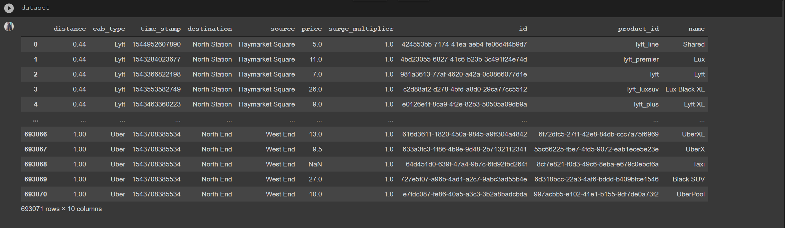

Slide 3
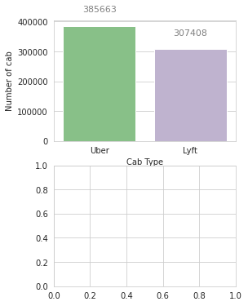

Slide 4
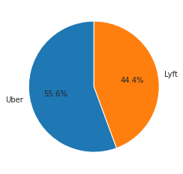

Slide 5


Slide 6
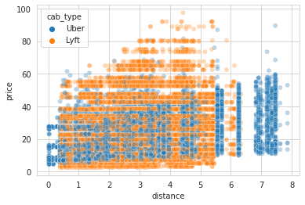

Slide 7
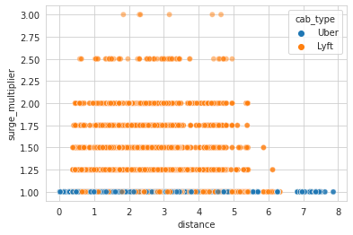

Slide 8
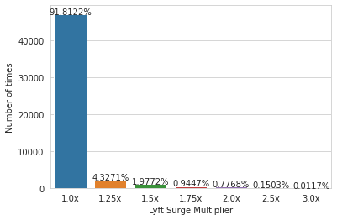

Slide 9
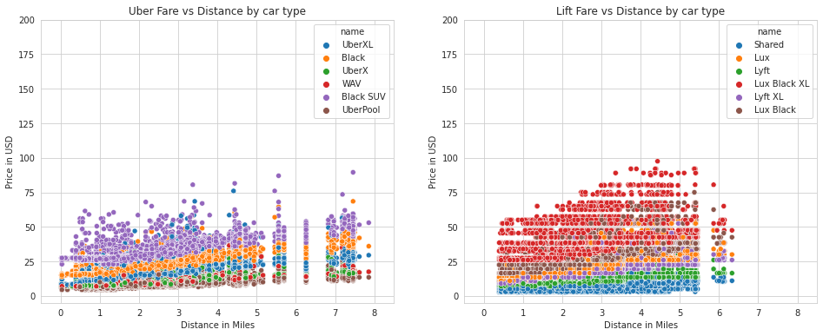

Slide 10
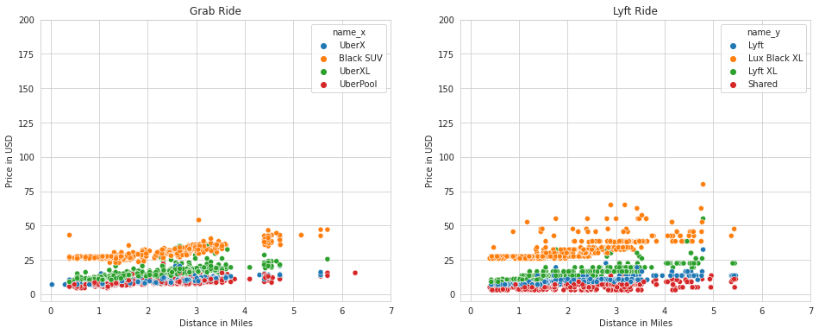

Slide 11
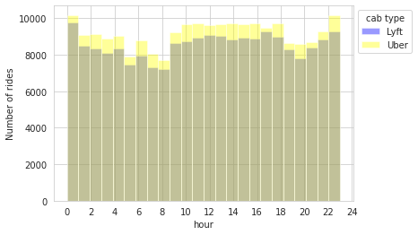

Slide 12
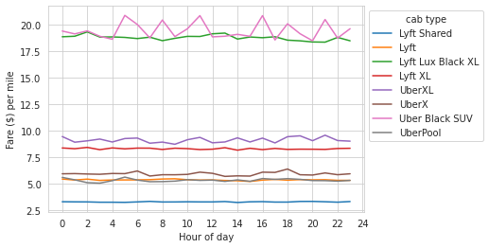

Slide 13
Conclusion
Lyft has more surge charges during rush hours.
Lyft is less expensive than Uber at it’s normal place.
Uber has more cabs available at late hours than Lyft.
Uber accepts more longer distance rides than Lyft.
From a non car owner point’s view, prefer Uber if you have something to do urgently. Otherwise, wait for Lyft at it’s normal price.

